Slide 1
Azure Storage and Cognitive Services
[ Instructor Name ]
[ Instructor E-mail ]

Slide 2
Azure Storage
Blobs
Storage for any type of data, analogous to files in a file system, with individual blobs storing up to 1 TB of data
Queues
Reliable messaging for workflow processing and for communication between applications or application components
Tables
NoSQL data storage rapid development and fast access to large quantities of data
Files
File sharing using Server Message Block (SMB) protocol
Notes:
Microsoft Azure Storage is a set of services that allows you to store large volumes of data in a cost-effective manner and in a way that makes the data readily and reliably available to services and applications that consume it. Data committed to Azure Storage can be stored in blobs, tables, queues, or files. Azure blobs are ideal for storing images, videos, and other types of data, and are frequently used to provide input to and capture output from other Azure services such as Azure Stream Analytics. Azure tables provide NoSQL storage for semi-structured data. Azure queuessupport queued message transfers between applications (or parts of applications) and can be used to make applications more scalable and robust by loosely coupling them together. Finally, Azure Files use the Server Message Block (SMB) protocol to share files through the cloud and access storage as network drives.
Data stored in Microsoft Azure Storage can be accessed over HTTP or HTTPS using straightforward REST APIs, or it can be accessed using rich client libraries available for many popular languages and platforms, including .NET, Java, Android, Node.js, PHP, Ruby, and Python. The Azure Portal includes features for working with Azure Storage, but richer functionality is available from third-party tools, many of which are free and some of which work cross-platform

Slide 3
Blob Storage
Accounts
Containers
Blobs
images
schema.jpg
dxlabs
Png/flow.png
documents
Labs.pdf
3 to 24 characters
0-9 and a-z
Unique within Azure
3 to 63 characters
0-9, a-z, and dashes
1 to 1,024 characters
Any characters (including slashes)
URL characters must be escaped
Max. 254 path segments
Notes:
Storage begins with a storage account, which can be created in the Azure Portal. Before you can create a blob, you must create a container to store it in. Think of containers as folders in a file system and blobs as the files themselves. Storage accounts must be uniquely named and conform to a rather severe set of restrictions since storage names are used to form DNS names.

Slide 4
Blob URLs
Accounts
Containers
Blobs
images
schema.jpg
dxlabs
Png/flow.png
documents
Labs.pdf
https://dxlabs.blob.core.windows.net/images/schema.jpg
Notes:
Once created, a blob can be referenced by URL. The URL is formed from the storage-account name, container name, and blob name. This doesn't mean all blobs are public; they're private by default. But they can be made public, and public blobs can be downloaded simply by typing their URLs into a browser.

Slide 5
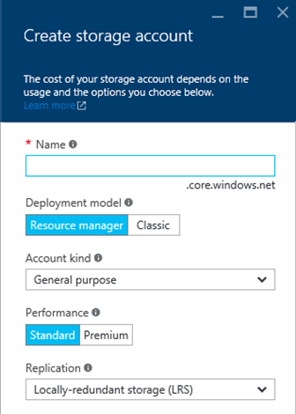
Storage Accounts
Up to 500 TB of data per account
Maximum of 100 storage accounts per subscription
Two types of accounts
"General purpose" and "Blob storage"
Four types of replication
LRS, ZRS, GRS, and RA-GRS
Support optional 256-bit AES encryption (currently in preview)
Notes:
Locally redundant storage (LRS) maintains three copies of your data. LRS is replicated three times within a single facility in a single region. LRS protects your data from normal hardware failures, but not from the failure of a single facility.
Zone-redundant storage (ZRS) maintains three copies of your data. ZRS is replicated three times across two to three facilities, either within a single region or across two regions, providing higher durability than LRS. ZRS ensures that your data is durable within a single region.
Geo-redundant storage (GRS) is enabled for your storage account by default when you create it. GRS maintains six copies of your data. With GRS, your data is replicated three times within the primary region, and is also replicated three times in a secondary region hundreds of miles away from the primary region, providing the highest level of durability. In the event of a failure at the primary region, Azure Storage will failover to the secondary region. GRS ensures that your data is durable in two separate regions.
Read access geo-redundant storage (RA-GRS) replicates your data to a secondary geographic location, and also provides read access to your data in the secondary location. Read-access geo-redundant storage allows you to access your data from either the primary or the secondary location, in the event that one location becomes unavailable.

Slide 6
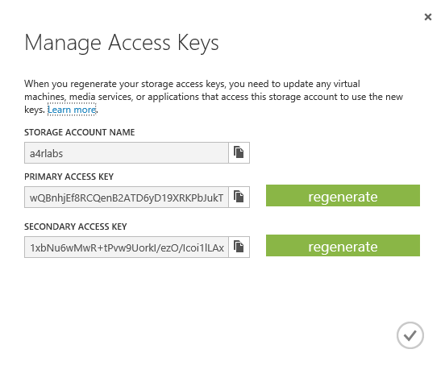
Storage Keys
Access to storage by non-account-owners relies on keys for authentication
Two 512-bit keys per account
Keys should be "rolled" periodically for security
Keys can be used to generate shared-access signatures (SAS) for secure and restricted access
Notes:
Access keys should never be handed out to other people because they provide unrestricted access to a storage account. (They're useful for connecting other services that you create to your storage accounts, in which case they stay in Azure and are never divulged to the outside world.) SAS tokens are safer because they can be time-limited and set to provide read-only access. The best way to generate a SAS token is with Microsoft's cross-platform Azure Storage Explorer. For a real-world example of what happens when you fail to protect a storage account's access keys, see http://www.pcworld.com/article/2365602/hacker-puts-full-redundancy-codehosting-firm-out-of-business.html.

Slide 7
Shared-Access Signatures
Blob URL
https://a4rlabs.blob.core.windows.net/images/schema.jpg?
st=2016-02-07T19%3A58%3A00Z&se=2016-02-08T19%3A58%3A00Z&sp=r&sv=2015-02-21&sr=b&sig=BGebg1eduvPTwQnZWZlBphM8YGP9sRYt2WiPIL70vcw%3D
Query string containing
shared-access signature
Notes:
This example shows how a SAS included in a query string can be used to provide access to an otherwise private blob. Could someone modify the query string to extend the lifetime of the SAS? They could try, but the SAS is digitally signed, so Azure will reject a modified SAS.

Slide 8
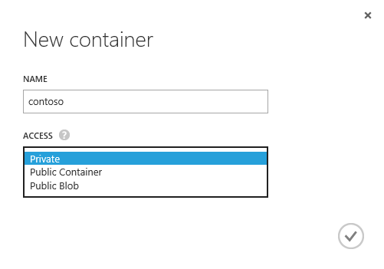
Storage Containers
Unlimited number of blob containers per storage account
Three access policies
Private – Blobs can't be read or enumerated anonymously
Public Container – Blobs can be read and enumerated anonymously
Public Blob – Blobs can be read anonymously, but cannot be enumerated
Notes:
Containers are private by default, which means only the storage-account owner (or someone who has an access key for the storage account or a valid SAS) can access its contents. However, setting the container's access policy to "Public Container" or "Public Blob" makes the container's blobs public. The difference between "Public Container" and "Public Blob" is that the latter allows the blobs in the container to be enumerated, while the latter does not.

Slide 9
Storage Blobs
Unlimited number of blobs per container
Three types of blobs
Blobs also support user-defined metadata (key-value pairs)
Block
Up to 195 GB
General-purpose streaming and storage
Append
Up to 195 GB
Optimized for append operations
Page
Up to 1 TB
VHDs only; optimized for random access
Notes:
Most blobs are block blobs. Page blobs are for VHDs and are used for VMs created in Azure. Most tools that let you create blobs -- for example, the Microsoft Azure Storage Explorer -- let you specify the blob type. APIs for creating blobs also let you specify the blob type.

Slide 10
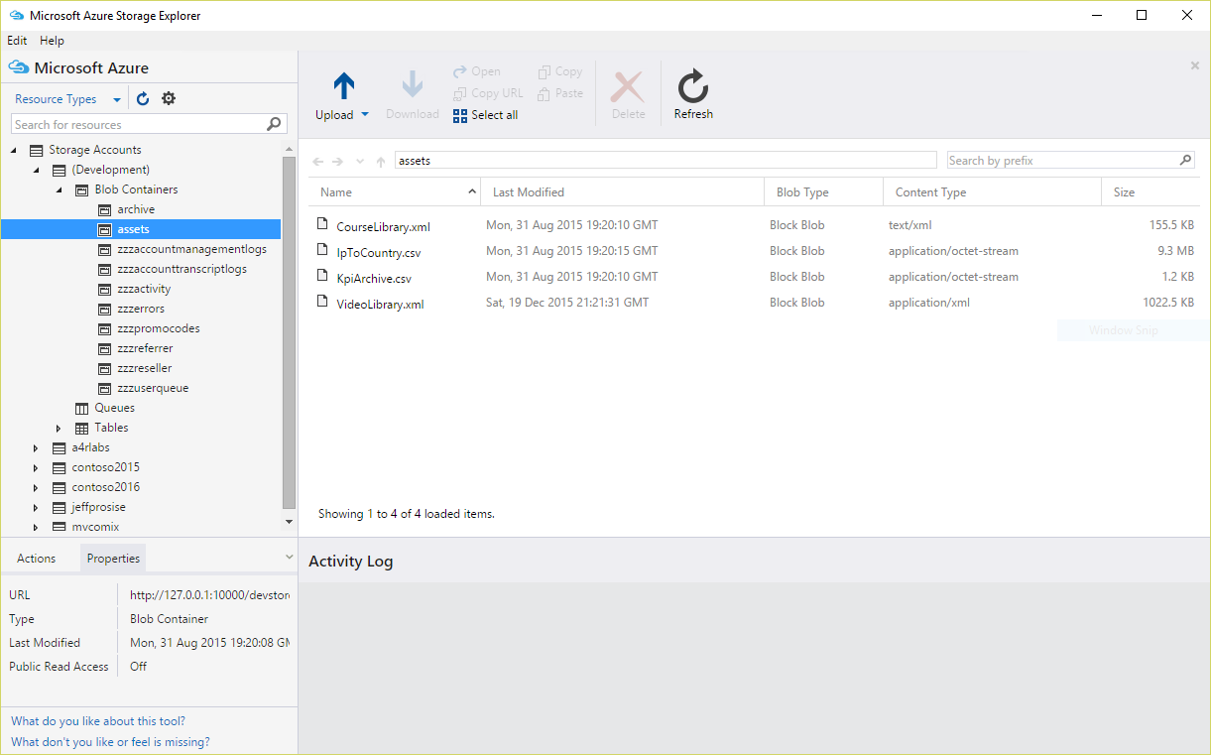
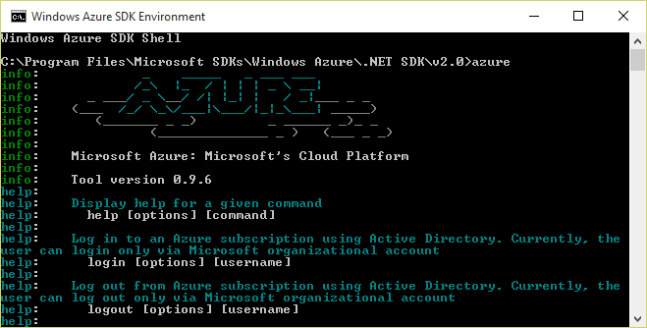
Azure Storage Tools
Portal doesn't provide functionality for uploading blobs
Use free, third-party, cross-platform tools instead
Microsoft Azure Storage Explorer
Azure Command-Line Interface (CLI)
Notes:
The Microsoft Azure Storage Explorer provides an easy-to-use GUI interface for creating containers, uploading and downloading blobs, generating SAS tokens, and more. But if you want to use a scripting language such as Bash or PowerShell to script storage operations, the Azure CLI is the way to go.

Slide 11
Accessing Blob Storage Programmatically
Blob service can be accessed using REST APIs
Accessible to any programming language that supports HTTP(S)
Blob service can also be accessed using Azure Storage SDKs available for popular languages and platforms
Also available from NuGet, NPM, and other package managers
.NET
Node.js
Java
C++
PHP
Ruby
Python
iOS
Xamarin
Notes:
Azure provides a very rich REST-based API for blob storage. Microsoft also provides free libraries/SDKs for popular platforms and languages that wrap the REST API and simplify the code that you write.

Slide 12
Uploading a Blob (C#)
Create a blob in the specified storage account and specified container using the Azure Storage SDK for .NET
Upload the contents of a local file to the blob
Get the connection string for the storage account from the Azure portal
CloudStorageAccount account =
CloudStorageAccount.Parse("connection_string);
CloudBlobClient client = account.CreateCloudBlobClient();
CloudBlobContainer container =
client.GetContainerReference("container_name");
CloudBlockBlob blob =
container.GetBlockBlobReference("blob_name"));
await blob.UploadFromFileAsync("file_name");
// Or use UploadFromStreamAsync or
// UploadFromByteArrayAsync

Slide 13
Downloading a Blob (Node.js)
Get a reference to a specified blob in a specified container in a specified storage account
Download the blob and store its contents in a local file
var storage = require("azure-storage");
var service =
storage.createBlobService("connection_string");
service.getBlobToLocalFile(
"container_name", "blob_name", "file_name",
function(error, result, response) {
if (!error) {
// File downloaded
}
});
// Or use getBlobToStream, getBlobToTest, or
// createReadStream

Slide 14
Enumerating Blobs in a Container (C#)
Enumerate all the block blobs in a specified container in a specified storage account
Retrieve the name of each blob
IListBlobItem could CloudBlockBlob, Cloud-PageBlob, or Cloud-AppendBlob
CloudStorageAccount account =
CloudStorageAccount.Parse("connection_string);
CloudBlobClient client = account.CreateCloudBlobClient();
CloudBlobContainer container =
client.GetContainerReference("container_name");
foreach (IListBlobItem item in container.ListBlobs())
{
var blob = item as CloudBlockBlob;
if (blob != null)
{
string name = blob.Name;
}
}

Slide 15
Writing Blob Metadata (Node.js)
Add metadata properties named "Property1," "Property2," and "Property3" to a blob
var storage = require("azure-storage");
var service =
storage.createBlobService("connection_string");
var metadata = {
"Property1", "Value1",
"Property1", "Value2",
"Property1", "Value3"
};
service.setBlobMetaData("container_name", "blob_name",
metadata, function(error, result, response) {
if (!error) {
// Succeeded
}
});

Slide 16
Reading Blob Metadata (C#)
Read metadata properties named "Property1," "Property2," and "Property3" from a blob
blob.FetchAttributes();
string p1 = blob.Metadata.ContainsKey("Property1") ?
blob.Metadata["Property1"] : null;
string p2 = blob.Metadata.ContainsKey("Property2") ?
blob.Metadata["Property2"] : null;
string p3 = blob.Metadata.ContainsKey("Property3") ?
blob.Metadata["Property3"] : null;

Slide 17
Deleting a Blob (Node.js)
Get a reference to a specified blob in a specified container in a specified storage account
Delete the blob
var storage = require("azure-storage");
var service =
storage.createBlobService("connection_string");
service.deleteBlob("container_name", "blob_name",
function(error, response) {
if (!error) {
// Blob deleted
}
});

Slide 18

Microsoft Cognitive Services
Intelligence APIs for building intelligent apps
Notes:
Cognitive Services includes 21 APIs that fall into five categories: vision, speech, language, knowledge, and search.

Slide 19
Cognitive Services APIs
Vision
Computer Vision
Emotion
Face
Video
Speech
Bing Speech
Custom Recognition
Speaker Recognition
Language
Bing Spell Check
Language Understanding
Linguistic Analysis
Text Analytics
Web Language Model
Knowledge
Academic Knowledge
Entity Linking
Knowledge Exploration
Recom-mendations
Search
Bing Auto-suggest
Bing Image Search
Bing News Search
Bing Video Search
Bing Web Search
Notes:
Microsoft Cognitive Services is a set of intelligent APIs for building equally intelligent applications. It currently offers 21 different API for analyzing images, videos, text, and much more. For more information, visit https://www.microsoft.com/cognitive-services.

Slide 20
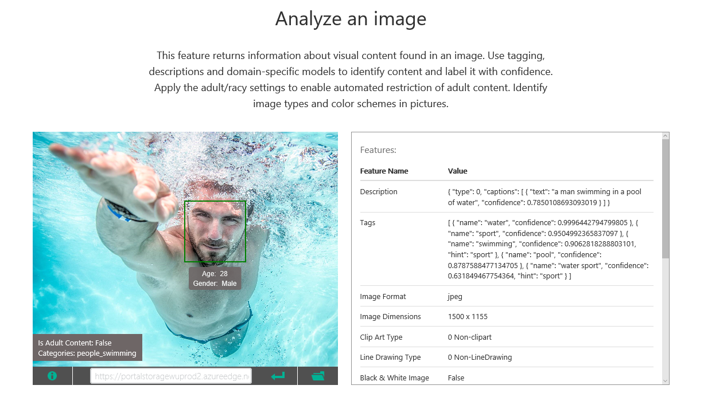
Computer Vision API
Notes:
The Computer Vision API, part of Cognitive Services, offers methods for captioning images, generating metadata keywords, recognizing celebrities, reading text, and generating "smart" thumbnails. For more information, visit https://www.microsoft.com/cognitive-services/en-us/computer-vision-api.

Slide 21
Using the Computer Vision API (C#)
Submit an image via URI to the Computer Vision API and ask for captions and descriptive tags
Optionally pass a stream instead of a URI
Uses Microsoft.Project-Oxford.Vision NuGet package
Other VisualFeatures include Adult, Category, Color, Faces, ImageType, and Tags
VisionServiceClient vision =
new VisionServiceClient("subscription_key");
VisualFeature[] features =
new VisualFeature[] { VisualFeature.Description };
AnalysisResult result =
await vision.AnalyzeImageAsync(uri, features);
string caption = result.Description.Captions[0].Text);
foreach (string tag in result.Description.Tags)
{
// tag holds descriptive tag for image (e.g., "river")
}
Notes:
Students will write code similar to this in the next lab to submit images uploaded to a Web site to the Computer Vision API in order to generate captions and search keywords. This example is written in C# for Microsoft .NET.

Slide 22
Using the Computer Vision API (Node.js)
Submit an image via URI to the Computer Vision API and ask for captions and descriptive tags
Optionally pass a stream instead of a URI
Other VisualFeatures include Adult, Category, Color, Faces, ImageType, and Tags
var options = {
url: "https://api.projectoxford.ai/vision/v1.0/analyze",
qs: { visualFeatures: "Description" },
method: 'POST',
headers: {
'Content-Type': 'application/json',
'Ocp-Apim-Subscription-Key': 'subscription_key'
},
...
};
request(options, function(err, response, result) {
if(!err) {
var caption = result.description.captions[0].text;
}
});
Notes:
Students will write code similar to this in the next lab to submit images uploaded to a Web site to the Computer Vision API in order to generate captions and search keywords. This example is written in JavaScript for Node.js.

Slide 23
Hands-On Lab
Azure Storage and Cognitive Services HOL (MVC).html
Azure Storage and Cognitive Services HOL (Node).html

